Slide 1

Team 07
Notes:
Today we’re going to talk about our solution to Brain Tumour Charity

Slide 2

NGO challenge
Answering phone calls
Lack of centralization of knowledge/expertise
Notes:
To give some context,

Slide 3

Goals
Quick access to information
Simple user interface
Improve efficiency
Scalable
Notes:
Brain Tumour Charity main priority when designing the solution were to ensure
Quick accessible information (Latency)
Simple User (Easy use)
Efficiency (Better communication)
When the company grows

Slide 4

System Architecture
Web Browser
Search
Results
SQL Queries
Sourcing
Forms
Notifications
Information
Notes:
Our proposed solution uses Django framework
It stores data in SQLite- speed of access
HTML front end- Bootstrap, easy user infrace
Django is scalable- instragam
Allows extensions in the future for search which we will discuss later

Slide 5
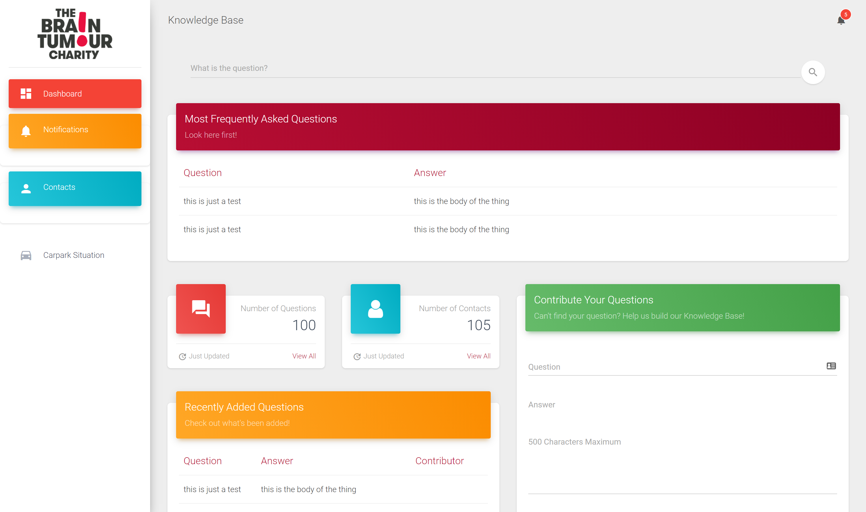
MOCKUP of proposed interface
Notes:
Features
One page webapp, at most one click to get or add information
-- speeds up response time during calls
Intuitive interface with colour coded sections for easy identification
-- facilitates quick user interactivity – user learns what colour to look out for
Global notification system – everyone currently on the page can see user-submitted notifications
-- improve intra-organizational coorperation and interaction via an easy to use medium (no need to shout anymore ☺)
We even have a carpark solution to track rogue cars
-- global notifications sent out with car details

Slide 6
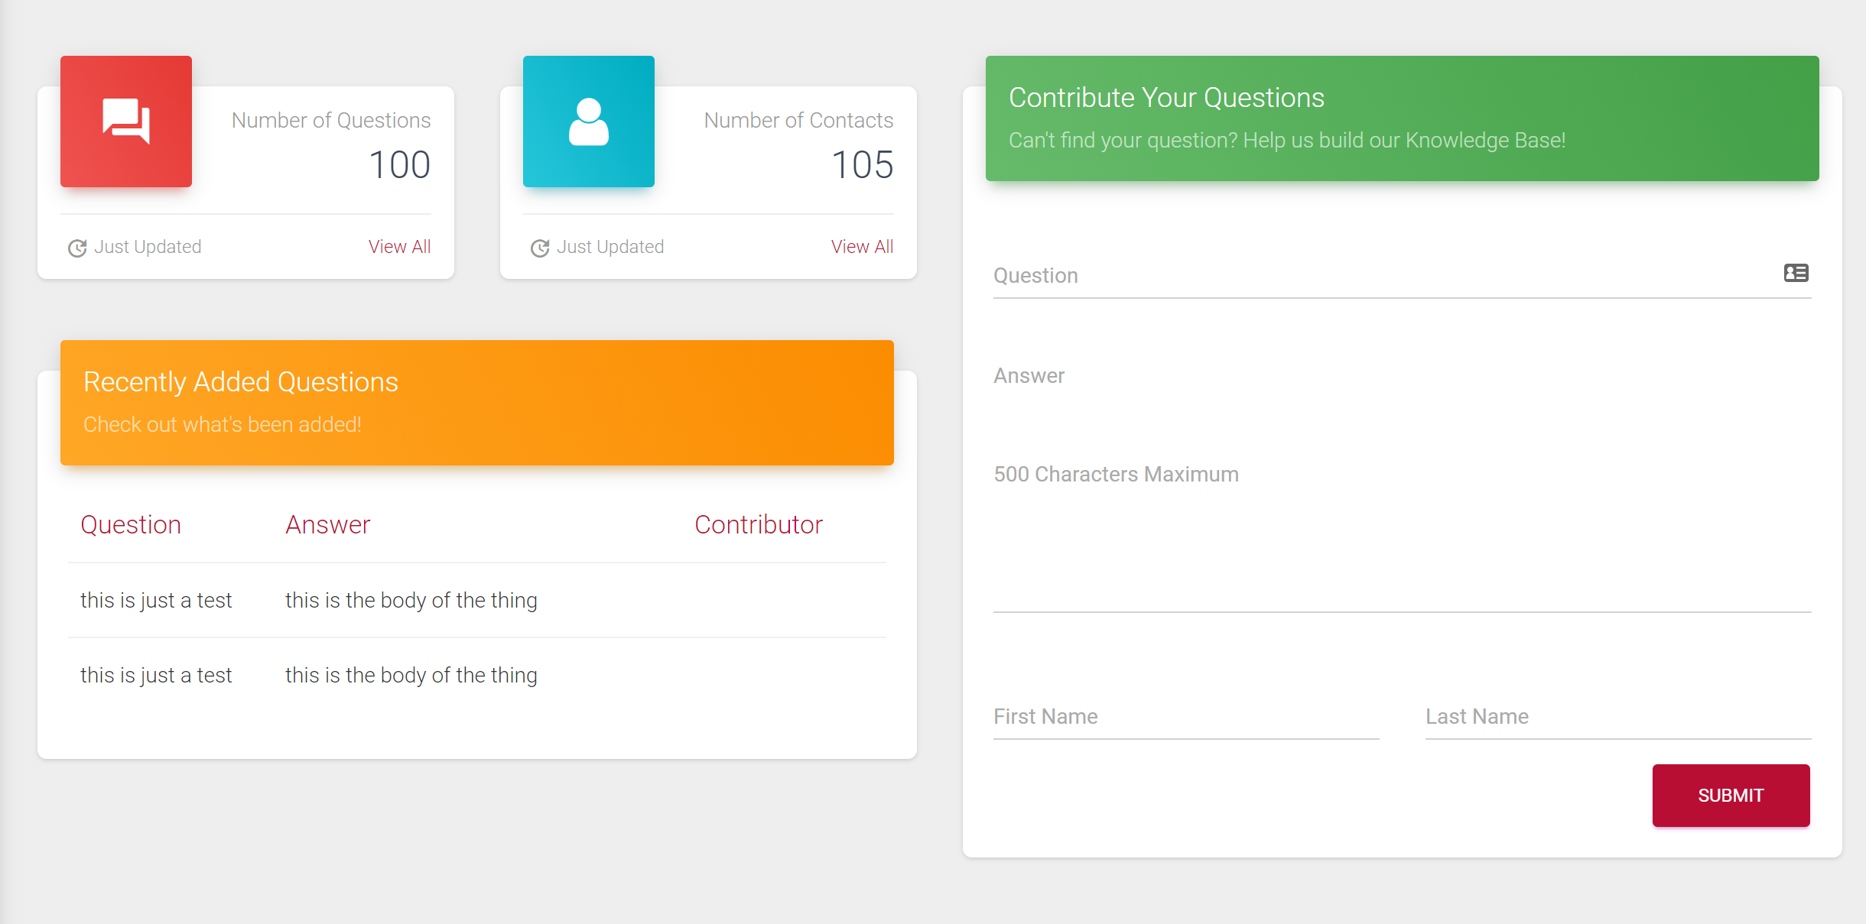
Notes:
Users are able to see all contributed questions and answers and a list of all contacts within the organization
-- transparency in information, allows for cross-checking
Users able to see recently added questions
-- since users would be using this daily, this helps keep them constantly learning more about new questions and information
Employees will be able to contribute to the knowledge base through the form
-- users credited for their contributions – potential incentive to contribute

Slide 7
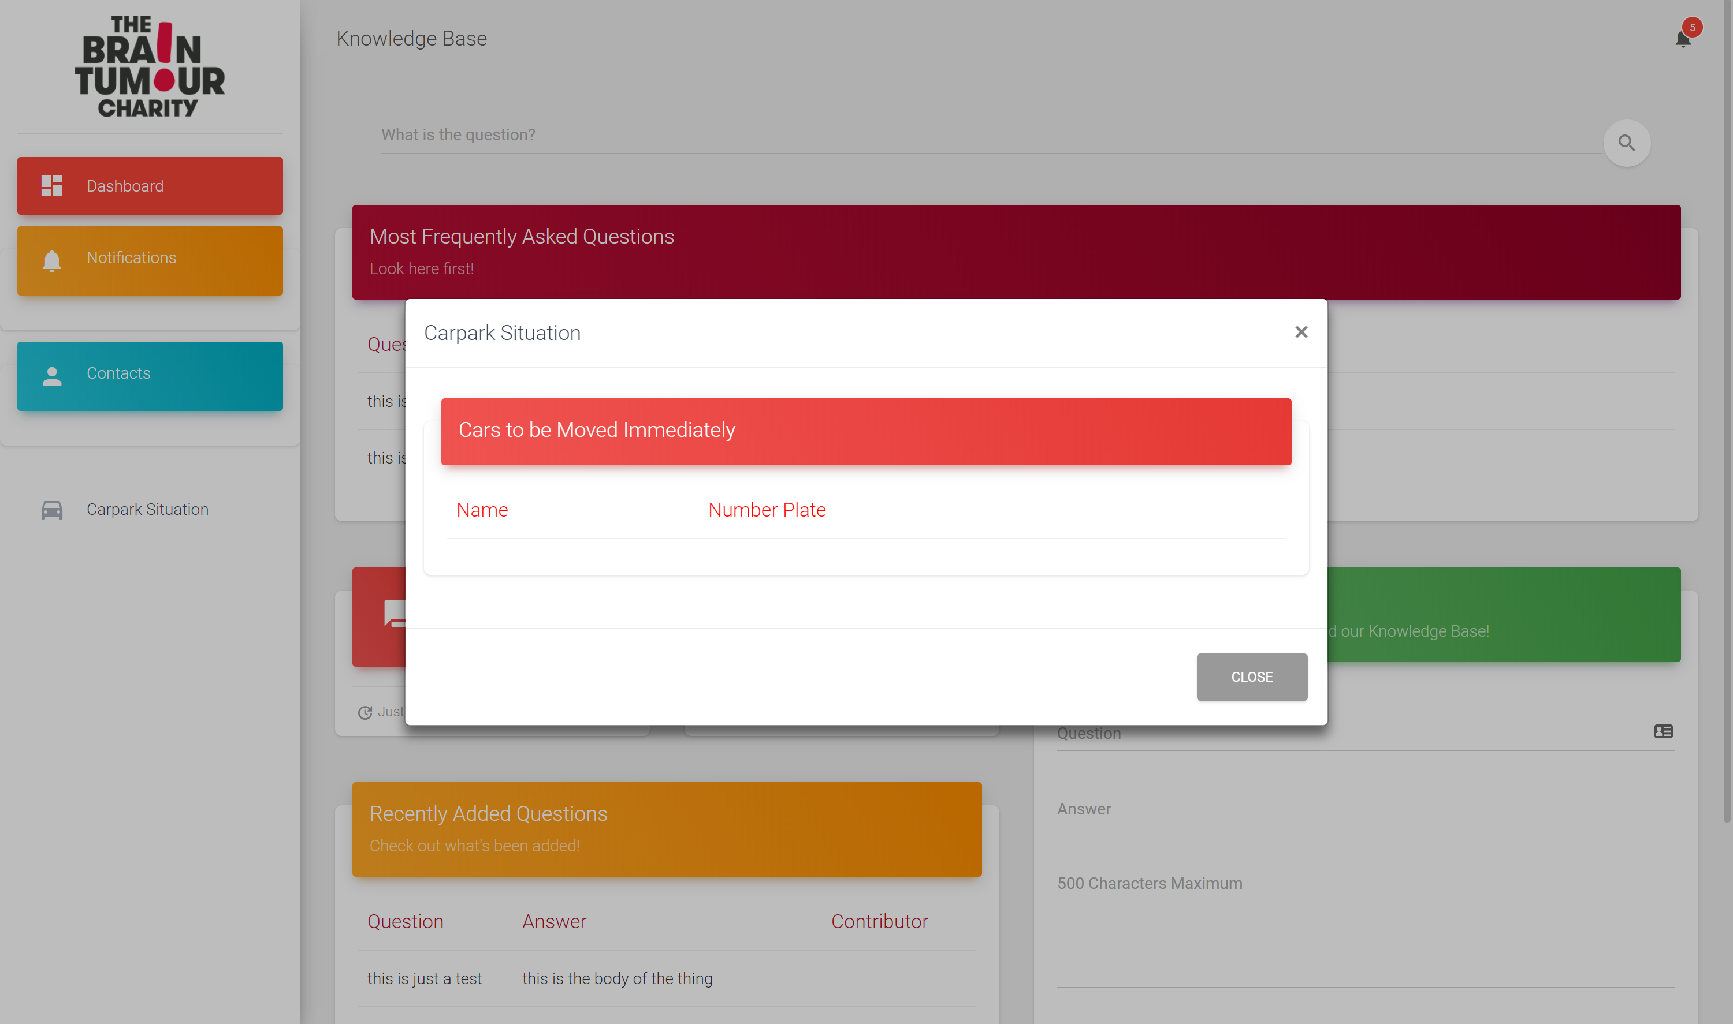
Notes:
Carpark situation can be mediated by broadcast of global notifications of rogue cars
Also a table consisting of all rogue cars

Slide 8
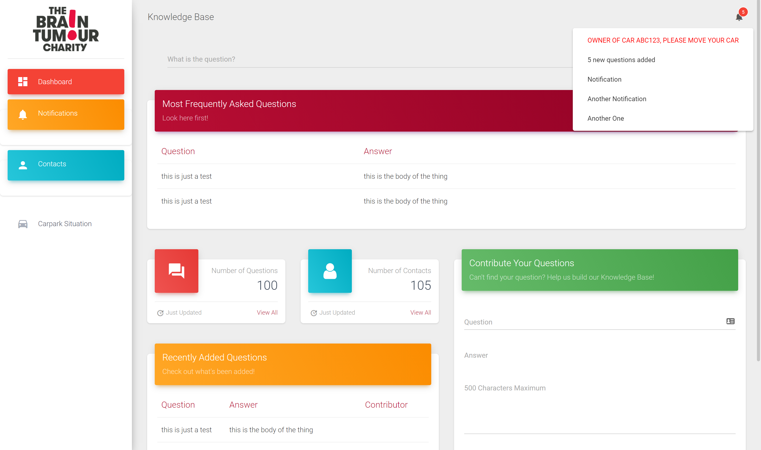
Notes:
Global notifications broadcasted, can also be user-submitted – greater coorperation within organization

Slide 9
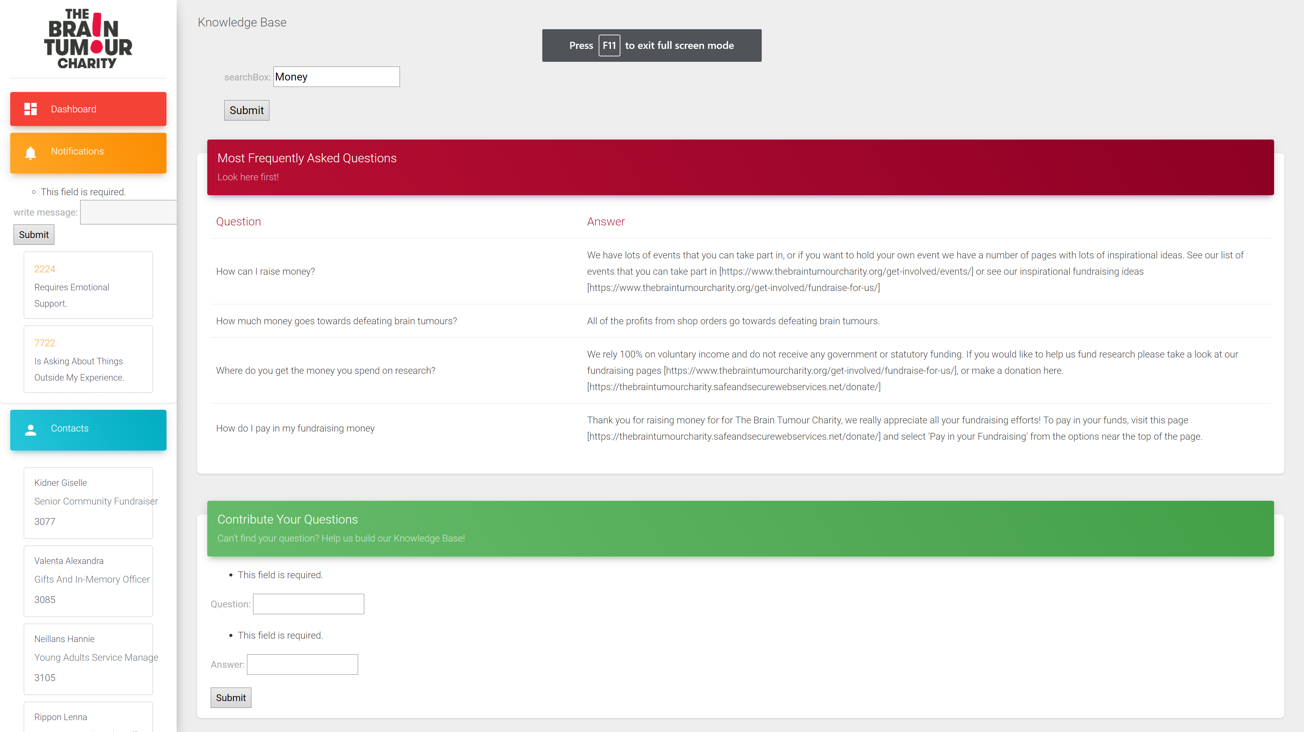
Current working solution
Notes:
we managed to get a basic search functionality working, the global notifications system, fetching existing questions and answers to give to user

Slide 10
Sustainability/feasibility
Low costs for hosting webapp, database etc.
Maintenance costs would be most significant especially during trial/trust-building period
Can use current servers used by the organization for their website
Easy to implement for testing and real execution
The benefits of faster response times to calls would allow greater reach, improved calling experiences

Slide 11
Future implementation
ElasticSearch
More dynamic user interface
Tags for each sub-topic
Automatic updating of database using webscraping, ML etc.
Open access to public (without sensitive information)
Approving of requests/validation system
Notes:
Tags for faster, more effective searches

